Slide 1

Binary Search Tree Strictly Binary Tree Complete Binary Tree
Data Structure | Tree and Heap
Course: Data Structure | Chapter: Tree and Heap | Program: Bachelor of Engineering | Institution: Chandigarh University
DISCOVER · LEARN · EMPOWER
Notes:
Welcome to our session on Tree and Heap structures. Today we focus specifically on three critical types of binary trees: Binary Search Trees, Strictly Binary Trees, and Complete Binary Trees. These structures form the backbone of efficient data organization in computer science. Let us begin by understanding their unique properties and applications.

Slide 2
Course Outcomes
SLIDE 2 / 14
Course Outcome
CO | BT LEVEL | DESCRIPTION
CO1 | BT1 | Understand and apply basic data structures, algorithms, complexity analysis, ADTs, arrays and linked lists.
CO2 | BT2 | Apply and implement stacks and queues in problem-solving.
CO3 | BT3 | Analyse and apply searching, sorting, and hashing techniques.
CO4 | BT4 | Construct and apply tree structures and traversal techniques.
CO5 | BT5 | Represent and solve graph problems using DFS, BFS, and graph algorithms.
Chandigarh University
2 / 14
Notes:
This lecture directly addresses CO1 by helping you understand and apply specific data structures like BSTs and their complexity. It also touches on CO5 as tree traversals are fundamental graph algorithms used in DFS and BFS implementations. Mastering these trees is essential for solving complex graph problems later in the course.

Slide 3
Learning Objectives
SLIDE 3 / 14
Learning Outcomes
1
Define the structural properties of Binary Search Trees and their ordering rules.
2
Distinguish between Strictly Binary Trees and Complete Binary Trees based on node counts.
3
Analyze the time complexity differences for search operations in these specific tree types.
4
Construct a valid Binary Search Tree from a given sequence of numerical inputs.
5
Identify common pitfalls when implementing insertion and deletion logic in BSTs.
Chandigarh University
3 / 14
Notes:
By the end of this session, you will be able to define and distinguish these three tree types clearly. You will learn to construct a BST from a sequence of numbers and understand why the order matters. We will also analyze why some trees offer faster search × than others.

Slide 4
Lecture
SLIDE 4 / 14
Binary Search Tree Definition and Rules
1
A Binary Search Tree is a rooted binary tree with ordered left and right subtrees.
2
Every node's left child must contain a value strictly less than the parent node.
3
Every node's right child must contain a value strictly greater than the parent node.
4
Both left and right subtrees must also satisfy the Binary Search Tree property recursively.
5
Duplicate values are typically not allowed or handled by specific insertion rules in BSTs.
6
The in-order traversal of a BST always yields a sorted sequence of values.
Chandigarh University
4 / 14
Notes:
Think of a BST like a phone book where names are sorted alphabetically. If you look for 'Smith', you go right if the current name is before 'Smith' and left if it is after. This ordering allows us to eliminate half the tree with every comparison, making searches very efficient.

Slide 5
Worked Example
SLIDE 5 / 14
Constructing a BST
INSERT SEQUENCE
50, 30, 70, 20, 40, 60, 80 into an initially empty BST.
• Insert 50 as the root node since the tree is currently empty.
• Insert 30: compare with 50, 30 is less, so place 30 as the left child.
• Insert 70: compare with 50, 70 is greater, so place 70 as the right child.
• Insert 20: compare with 50 (left), then 30 (left), place 20 as left of 30.
• Final structure has 20, 30, 40 on the left and 60, 70, 80 on the right.
Chandigarh University
5 / 14
Notes:
Let's trace the insertion of 20. We start at 50, go left to 30, and since 20 is less than 30, we go left again. This creates a path of comparisons. If we insert 40 next, it goes right of 30 but left of 50. This specific placement maintains the sorted order property essential for the BST.

Slide 6
Lecture
SLIDE 6 / 14
Strictly Binary Tree Definition
1
A Strictly Binary Tree is a tree where every node has either zero or two children.
2
No node in a Strictly Binary Tree can have exactly one child node.
3
Every internal node must have both a left child and a right child present.
4
Leaf nodes in a Strictly Binary Tree have zero children by definition.
5
This structure is often used in Huffman coding and expression tree representations.
6
A tree with a single root node is considered a Strictly Binary Tree.
Chandigarh University
6 / 14
Notes:
Imagine a family tree where every parent either has no children or exactly two children. You never see a parent with just one child. This is crucial in Huffman coding where we combine two nodes to create a new parent, ensuring no single-child nodes exist in the final tree.

Slide 7
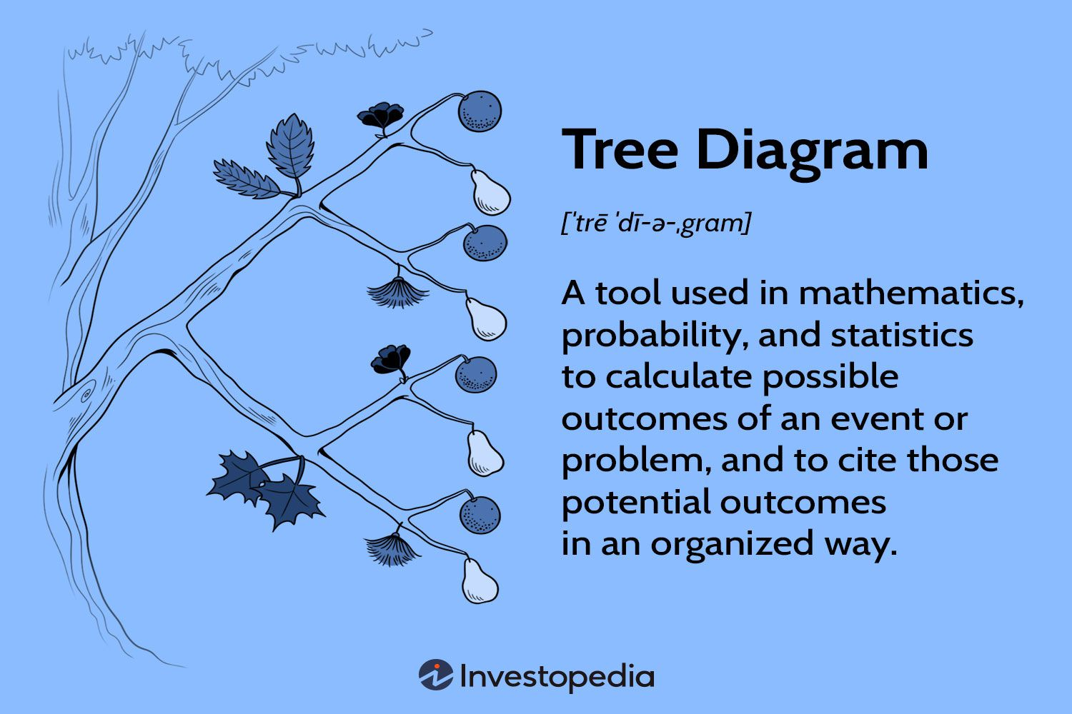
Lecture
SLIDE 7 / 14
Strictly Binary Tree Numerical Property
GOVERNING EQUATION
Formula: Number of Leaves = Number of Internal Nodes + 1
1
In a Strictly Binary Tree, the number of leaf nodes is always one greater than internal nodes.
2
Total nodes in a Strictly Binary Tree is always an odd number.
3
If a tree has 10 internal nodes, it must have exactly 11 leaf nodes.
4
Total nodes = 2 × (Number of Internal Nodes) + 1.
5
This property holds true regardless of the specific values stored in the nodes.
Source: www.investopedia.com
Chandigarh University
7 / 14
Notes:
Let's verify this with a small example. If we have a root with two leaves, we have 1 internal node and 2 leaves. 2 equals 1 plus 1. If we expand one leaf into two new leaves, we gain one internal node and one leaf, maintaining the difference of one. This invariant is a powerful check for tree validity.

Slide 8
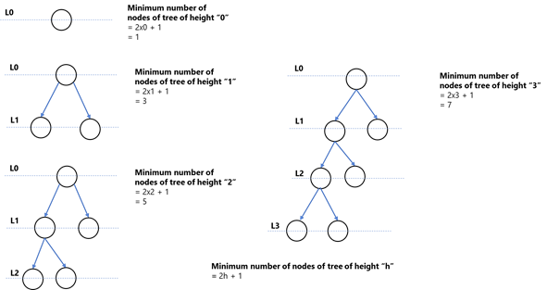
Lecture
SLIDE 8 / 14
Complete Binary Tree Definition
1
A Complete Binary Tree is filled level by level from left to right without gaps.
2
All levels except possibly the last are completely filled with nodes.
3
The last level has all nodes as far left as possible.
4
This structure allows efficient storage in a simple array without wasted space.
5
It is the standard structure used for implementing binary heaps efficiently.
6
A tree with a single node is considered a Complete Binary Tree.
Source: dz2cdn1.dzone.com
Chandigarh University
8 / 14
Notes:
Think of a Complete Binary Tree like a queue of people waiting for a bus. Everyone fills the seats from the front row to the back, and within the last row, they sit from left to right. There are no empty seats in between people. This compactness is why we use arrays to store them.

Slide 9
Lecture
SLIDE 9 / 14
Complete Binary Tree Array Mapping
1
Root node is stored at index 0 in the array representation.
2
For a node at index i, left child is at index 2i + 1.
3
For a node at index i, right child is at index 2i + 2.
4
For a node at index i, parent is at index floor((i - 1) / 2).
5
This mapping eliminates the need for explicit pointers in memory.
6
Accessing any node takes constant time O(1) using this index calculation.
Chandigarh University
9 / 14
Notes:
Let's map a node at index 2. Its left child is at 2(2) + 1 = 5, and its right child is at 2(2) + 2 = 6. Its parent is at floor((2-1)/2) = 0. This mathematical relationship allows us to navigate the tree using simple arithmetic, which is much faster than following pointer links.

Slide 10
Comparison
SLIDE 10 / 14
BST vs Strictly Binary
1
BST focuses on value ordering for efficient search and retrieval operations.
2
Strictly Binary Tree focuses on structural balance of having 0 or 2 children.
3
A BST can have nodes with only one child, violating Strictly Binary rules.
4
A Strictly Binary Tree does not require values to be sorted or ordered.
5
BSTs are used for databases and search algorithms requiring fast lookups.
6
Strictly Binary Trees are used in compression algorithms like Huffman coding.
Chandigarh University
10 / 14
Notes:
It is important to note that a tree can be both a BST and a Strictly Binary Tree, but it is not required. A BST might have a node with only a right child, which disqualifies it from being Strictly Binary. Conversely, a Strictly Binary tree might have random values, making it useless for searching.

Slide 11
Comparison
SLIDE 11 / 14
BST vs Complete Binary
1
BST requires value ordering, while Complete Binary requires structural filling order.
2
A Complete Binary Tree does not guarantee that left children are smaller than right.
3
A BST is not necessarily Complete; it can be skewed or unbalanced.
4
Complete Binary Trees are ideal for Heap implementations due to array efficiency.
5
BSTs are ideal for dynamic sets where elements are frequently inserted and deleted.
6
A tree can be both Complete and a BST, but this is a specific case.
Chandigarh University
11 / 14
Notes:
Consider a Complete Binary Tree where the root is 10, left is 20, and right is 5. This is a valid Complete Binary Tree but not a BST because 20 is greater than 5 but on the left. The structural property of being 'full' is independent of the value ordering property of a BST.

Slide 12
Lecture
SLIDE 12 / 14
Common Pitfalls in BST Implementation
1
Failing to handle duplicate values correctly can lead to infinite loops or errors.
2
Ignoring the recursive nature of BST insertion can cause structural violations.
3
Not balancing the tree can lead to O(n) search time in worst cases.
4
Assuming a BST is always balanced is a dangerous misconception for performance.
5
Incorrect pointer updates during deletion can disconnect parts of the tree.
6
Using a BST for data that is not comparable will cause runtime exceptions.
Chandigarh University
12 / 14
Notes:
A common mistake is inserting sorted data like 1, 2, 3, 4 into a BST without balancing. This creates a 'skewed' tree that looks like a linked list, degrading search time from O(log n) to O(n). Always remember that the power of a BST relies on it remaining somewhat balanced.

Slide 13
Lecture
SLIDE 13 / 14
Key Takeaways
1
BSTs use value ordering to enable efficient search, insert, and delete operations.
2
Strictly Binary Trees require every node to have 0 or 2 children.
3
Complete Binary Trees are filled left-to-right and map efficiently to arrays.
4
Leaf count in Strictly Binary Trees is always internal nodes plus one.
5
Understanding these distinctions is vital for selecting the right data structure.
Chandigarh University
13 / 14
Notes:
To summarize, remember that BSTs are about order, Strictly Binary Trees are about node degree, and Complete Binary Trees are about structural filling. Each serves a different purpose in algorithm design. Choosing the right one depends on whether you need fast searching, specific structural properties, or memory efficiency.

Slide 14
Lecture
SLIDE 14 / 14
References
DATA STRUCTURES
A Pseudocode Approach with C — Gilberg, Forouzan
• Data Structures — Lipschutz
• Data Structure Using C — AK Sharma
• C and Data structure — P. S. Deshpandey
Chandigarh University
14 / 14
Notes:
For further reading, please refer to the textbooks listed on this slide. Gilberg and Forouzan provide excellent pseudocode approaches, while Lipschutz offers a comprehensive theoretical foundation. AK Sharma and P. S. Deshpandey are also excellent resources for C-based implementations. Thank you for your attention.

